Slide 1




Motive bot
CSE495.2
Faculty: AZK
Rotan hawlader pranto 2013193042
MD Nazmus Sadat Samin 2012235042
Tanjila Ahmed Medha 2021004042

Slide 2
Introduction
Motive-bot is an AI-powered chatbot aimed at enhancing emotional well-being. It leverages Natural language processing and machine learning techniques.​ This project explores the development of a motivational chatbot leveraging the power of the DistilBERT model. DistilBERT's pre-trained capabilities for natural language processing offer a foundation for understanding user input and generating supportive, encouraging responses. By addressing limitations in data size the goal is to create a robust and impactful tool to empower users on their personal growth journeys

Slide 3
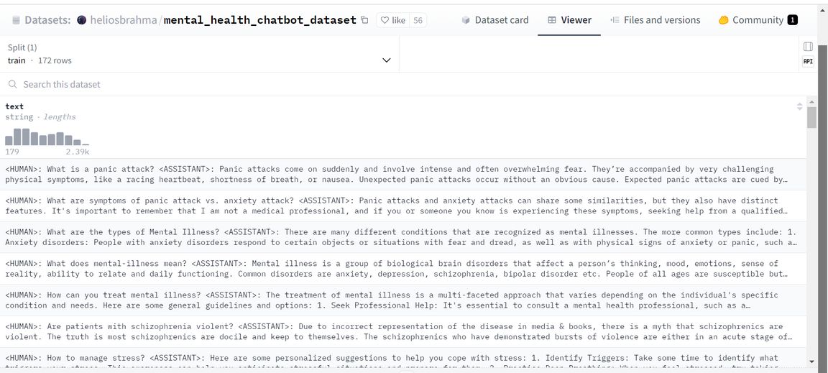
DATASET
It was difficult to find motivational dataset. the dataset was rare so we used this mental health dataset. It is from Hugging Face. This dataset contains conversational pair of questions and answers in a single text related to Mental Health.
DATASET LINK
https://huggingface.co/datasets/heliosbrahma/mental_health_chatbot_dataset
DATASET SIZE
506 KB
DATASET NUMBER OF CLASSES
it’s a text field dataset. Its only have one field which is called “Text”. This text field contains a prompt and its corresponding answer, health issues and motivation.
DATASET NUMBER OF ROWS
172 ROWS
DATASET SNAPSHOT

Slide 4

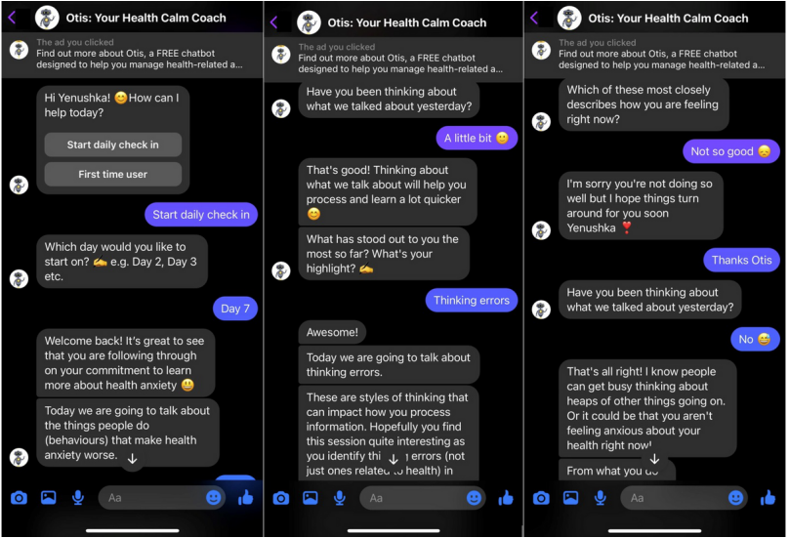

REleted works
​ A Cognitive Behavioral Therapy Chatbot (Otis) for Health Anxiety Management: Mixed Methods Pilot Study(Yenushka Goonesekera1, BSc, MHealthPsych; Liesje Donkin1,2 , MSc, PhD)
This paper talked about the increasing anxiety during covid-19. where people has to maintain social distance for a long time. their prior goal was to make a therapy bot which will help the people to decrease their mental health anxity.

Slide 5
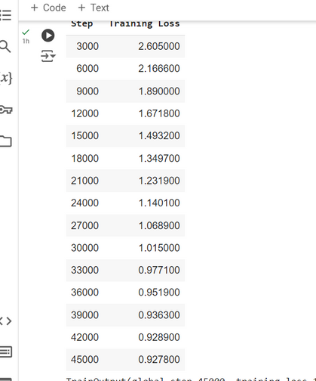
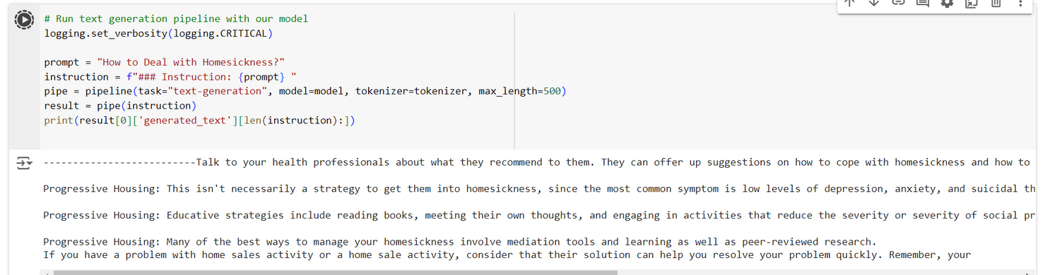
Stats
How long did it take to train?
It took almost 1 hour 12 minutes 45 seconds to complete 600 epochs, we fine-tuned this on the DistilBERT
model. We also fine-tuned on the llama-2 7B model but that took very much time to complete the epoch and sometimes its crash because of a lack of GPU.
How did you get the resources needed? Paid/free?
What was the average time spent on each epoch?
We used the model from Hugging Face which is well-known for NLP models, datasets and codes. So we took the DistilBert model from it. As we all know it's trained on the BERT model as a teacher. But it took fewer parameters and less time to train. This model is available on hugging face (distilbert/distilgpt2). We didn’t pay anything for this project.
We took 600 epoch which is 45000 steps to finetuned this model. Average per epoch it took 7.65 seconds. In llama-2 it took almost 30 TO 40 minutes to complete per epoch.
output:

Slide 6
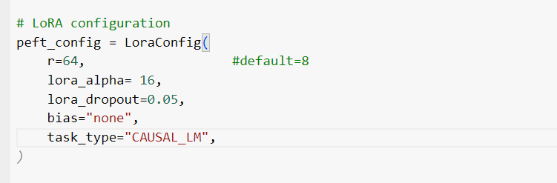
Optimization
As we already mentioned in the previous slide we used the DistilBert model for this motivational chatbot. We basically fine-tuned this pre-trained model on a custom dataset which is also available hugging face named mental_health_chatbot_dataset. This dataset consists of human sound prompts and responses for that prompt.
We used PEFT(Parameter Efficient Fine Tuning). PEFT adjusts a small number of key parameters while preserving most of the pre-trained model's structure to improve LLM performance. Basically in PEFT configuration, we have used LoRa which is a a technique that accelerates the fine-tuning of large language models while consuming less memory. Lora configuration, allows us to control how LoRA is applied to the model.

Slide 7
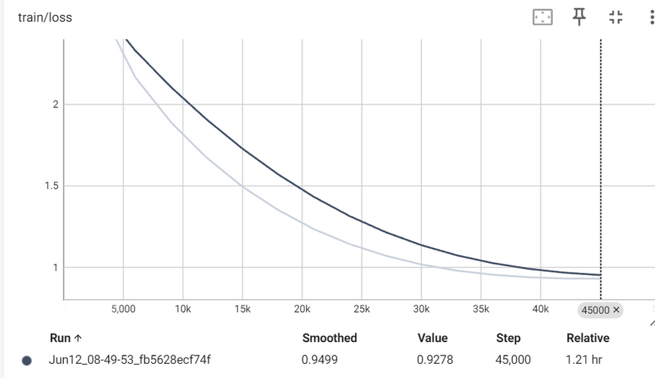
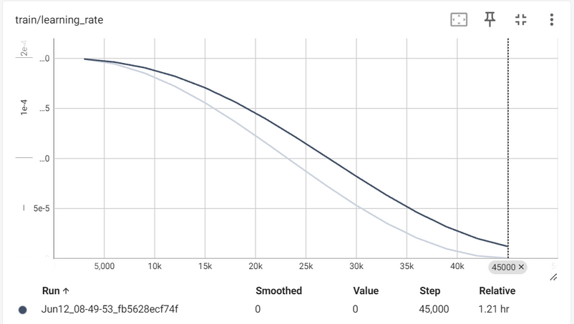
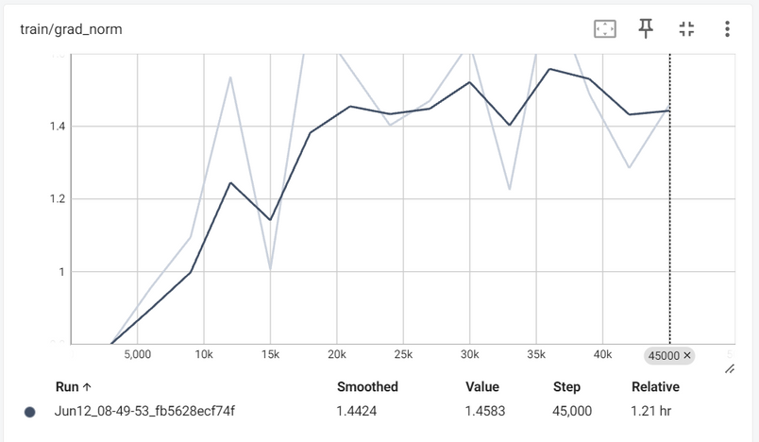
Metrics
We tried 3 times by different epoch numbers to see, if is it improving or declining. But Increasing epoch number always gave us the better training result.
We use the learning rate as 2e-4. Results are below
The graph of gradient norm per train is also attached in this slide.

Slide 8
Future work & Conclusion
While the current chatbot shows promise, a limited dataset and training loss hinder its effectiveness. Future work will focus on expanding the real-life data and optimizing training. Additionally, personalization, emotional intelligence, and multimodality will be explored to create a more impactful and engaging user experience. Clear evaluation metrics will be established to track progress and success.

Slide 9

Publication
As there is no commendable dataset on motivational conversion or related to this topic, it's not a better idea to go to a publication.
We also saw that the training loss is not appropriate for good output. The better the dataset is, the better the output will be.

